Slide 1


Start Smart 1.0
kindergarten
Lesson 11

Slide 2

ELD Objective
ELD Objective: Students will be able to engage in a Constructive Conversation using the Constructive Conversation Skill of NEGOTIATE, by taking turns, sharing ideas and making ideas clearer with a partner based on a visual text.

Slide 3
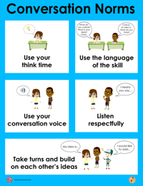
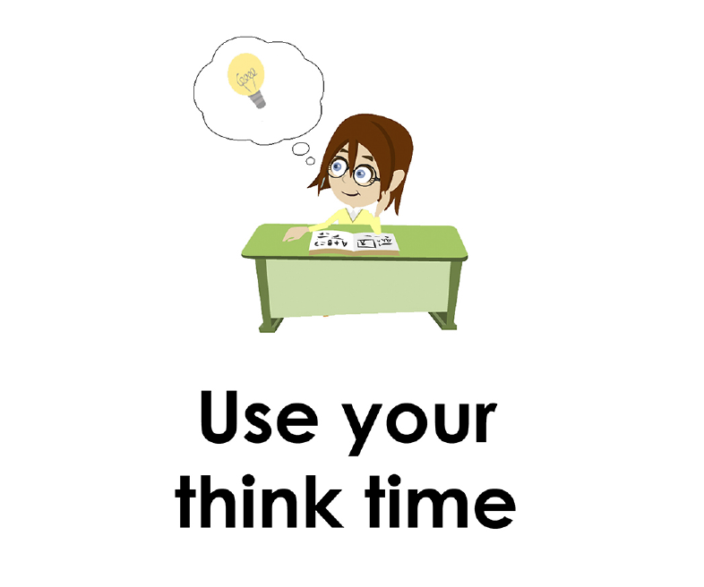
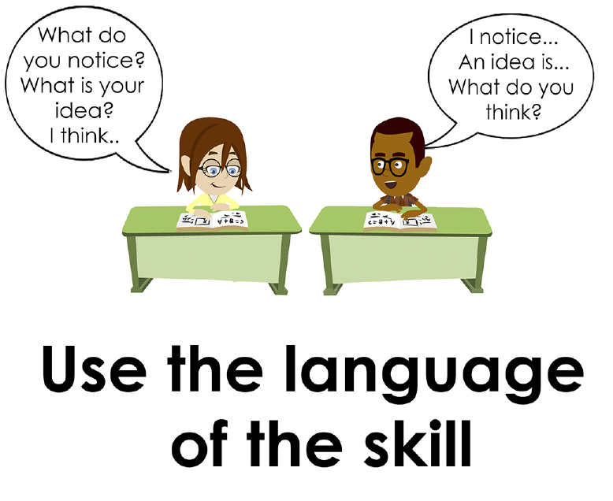
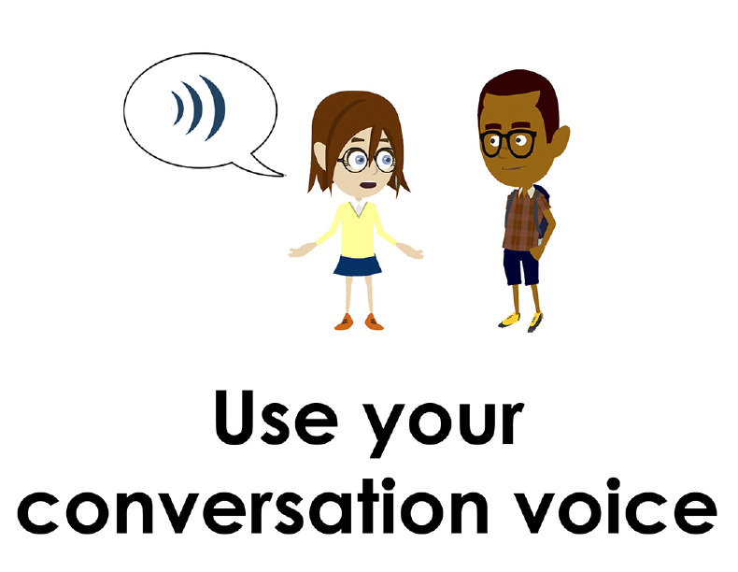
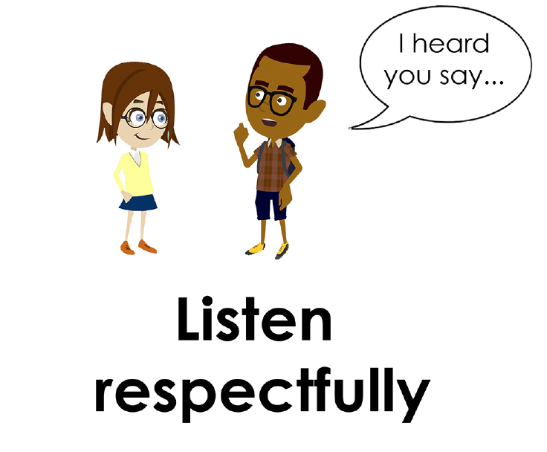
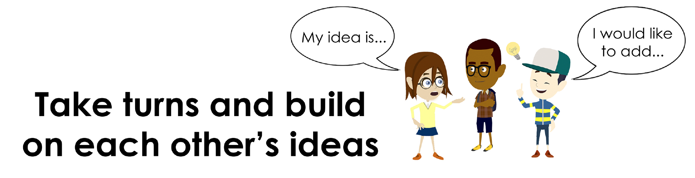
Conversation Norms Poster
  Use your think time
  Use the language of the skill
  Use your conversation voice
  Listen respectfully
  Take turns and build on each other’s ideas

Slide 4
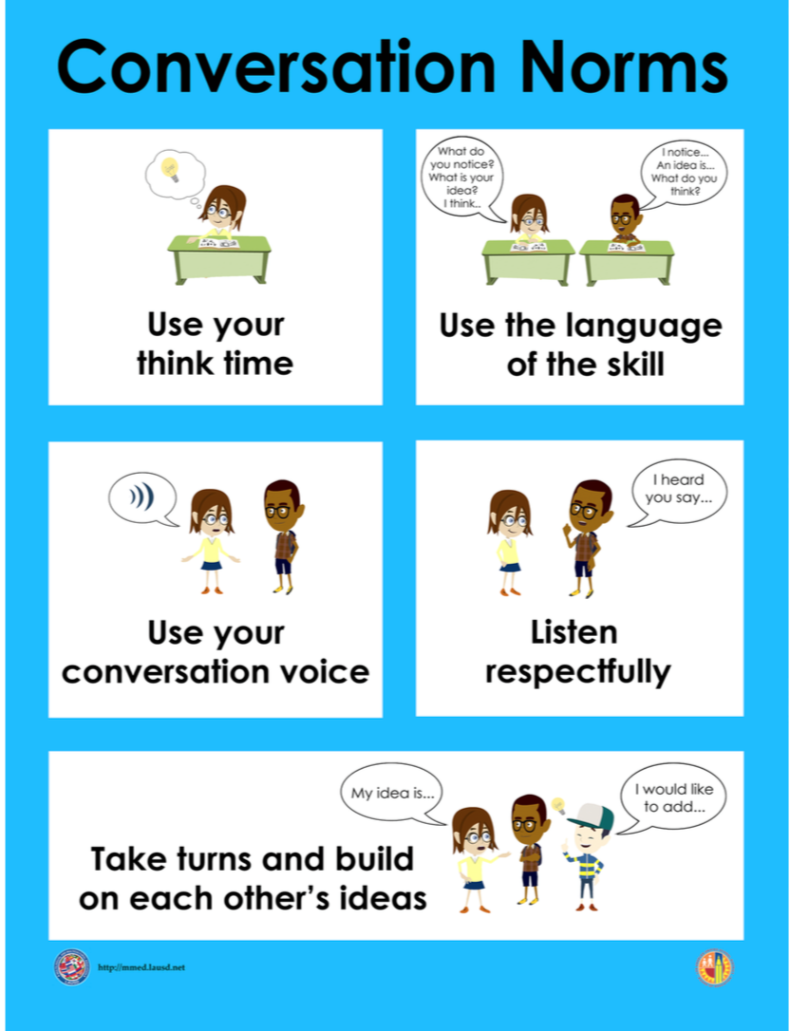
Notes:
The focus today is:
Use your think time
Use the language of the skill

Slide 5
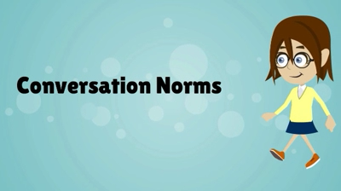
Conversation Norms
Notes:
Show Constructive Conversation Norms Video as a review of all norms

Slide 6
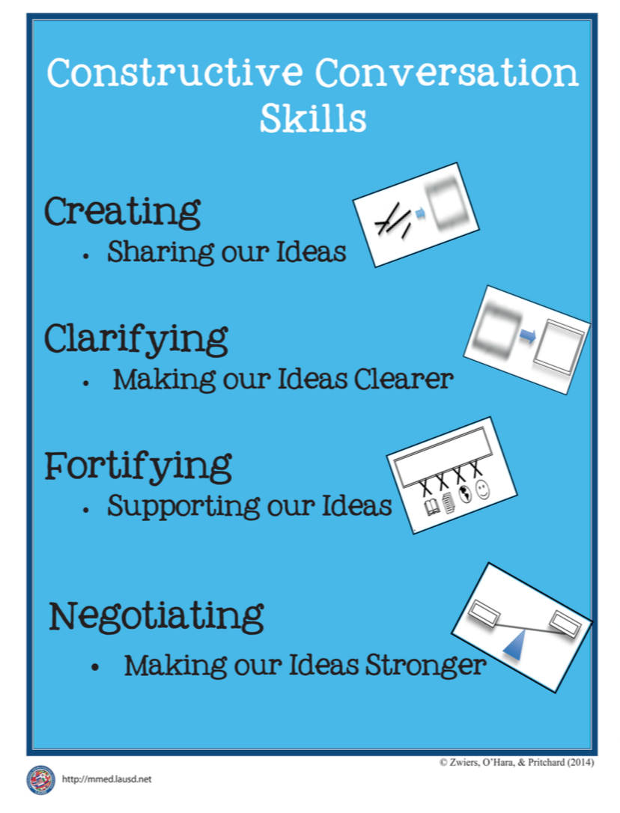
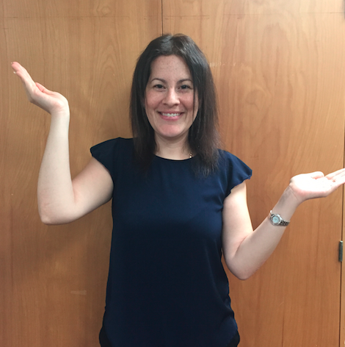
Hand Gesture and Phrase- NEGOTIATE
Making our Ideas Stronger
Notes:
Model NEGOTIATE and have participants repeat with you:
Place hand, palm down in front of you as if putting an idea on the table. Use four fingertips of the other hand to support the palm.

Slide 8
Prompt:
What is an important idea from this text? Start by stating your claim. Support your claim and come to a consensus.
TEACHER VISUAL TEXT

Slide 9


Listen to the Model Constructive Conversation
  Use your think time to study the visual text.
Listen actively to what two partners say to each other.
Notes:
Provide a copy of the Model Script to the volunteer and allow time beforehand for student to review the script. Suggestions for reading the script:
● Show a video of students having the model conversation (optional)
● Student volunteer and teacher read model script
STUDENT LISTEN ACTIVELY

Slide 10
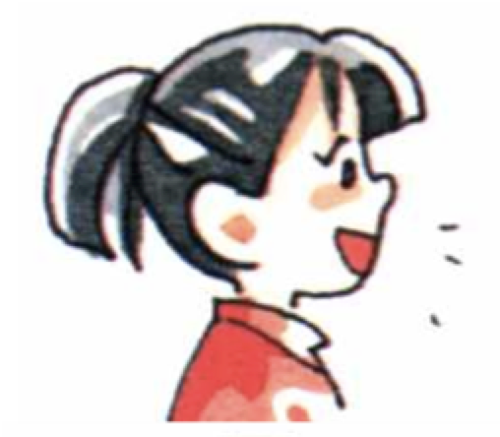
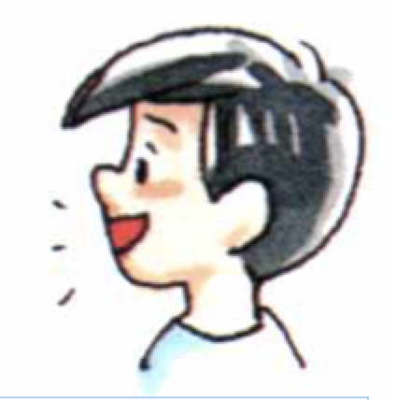
Visual Text Model
What is an important idea from this text? Start by stating your claim. Support your claim and come to a consensus.
Partner A: An important idea from the text is that we all can play together. What is your claim?
Partner A: I think that they used the blocks to make a seat for each one so they could all sit and play together. How can you support your claim with evidence?
Partner A: I think they all have a block in their hand and pretending to drive the truck together. How can you support your claim with evidence?
Partner A: I think that they are using the blocks and costumes to pretend that they are all construction workers. How can you support your claim with evidence?
Partner A: I think they worked together to build the truck and pretend they are construction workers. Can we come to an agreement?
Partner B: An important idea from the text is that we can use blocks to build things and pretend. How can you support your claim with evidence?
Partner B: I think that they used blocks to build a truck. How can you support your claim with evidence?
Partner B: I think that they used the blocks to make a truck with three seats and three driving wheels. How can your support your claim with evidence?
Partner B: I think they worked together at the block center. I notice there are also cubbies, an easel and a rug. How can we come to an agreement?
Partner B: I think the important idea is that we can play together to build things and pretend.

Slide 12
Listen to the Non-Model Constructive Conversation
  Use your think time to study the visual text.
Listen actively to what two partners say to each other.
Notes:
Provide a copy of the Non-­‐‑Model Script to the volunteer and allow time beforehand for student to review the script. Suggestions for reading the script:
● Show a video of students having the model conversation (optional)
● Student volunteer and teacher read model script
STUDENT LISTEN ACTIVELY

Slide 13
Visual Text Non- Model
What is an important idea from this text? Start by stating your claim. Support your claim and come to a consensus.
Partner A: I think an idea is they are playing. What do you think?
Partner A: I think they used blocks to make a truck. What do you think?
Partner A: I think they are all smiling. What do you think?
Partner A:I think they used the blocks to build a fire truck and pretend they are construction workers.
Partner B: I think an idea is they are pretending to be construction workers. What is your idea?
Partner B: I think they used blocks to make a truck. What do you think?
Partner B: I think they are playing in the blocks center. What do you think?
Partner B: I agree.

Slide 14
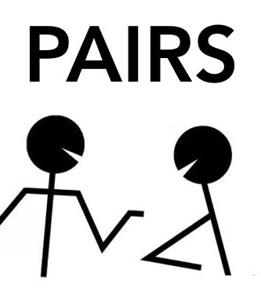
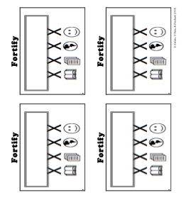
Constructive Conversation Game
PROMPT:
What is an important idea from this text? Start by stating your claim. Support your claim and come to a consensus.
Rules of the game:
Each of you needs 1 CREATE, 1 CLARIFY, 1 FORTIFY, and 2 NEGOTIATE cards
Each of you will play one card as you share an idea. You will continue taking turns until all cards are placed in the middle.
If you’re done early repeat the process for an additional round.
Remember to use the Constructive Conversation Norms and Skills as you play the game.
Notes:
You are now going to have the opportunity to practice the Constructive Conversation Skill NEGOTIATE while playing a game.
Explain the rules of the Constructive Conversation Game to students.

Slide 15
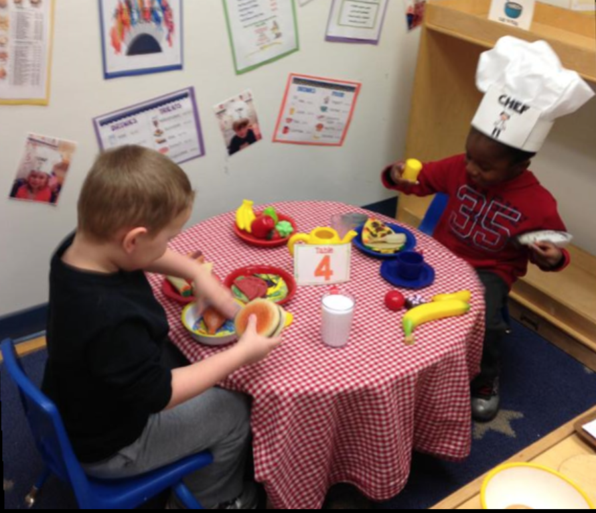

Prompt: What is an important idea from this text? Start by stating your claim. Support your claim and come to a consensus.
TEACHER COLLECTS LANGUAGE SAMPLE SPF 1.0
STUDENT VISUAL TEXT
Notes:
Display the Student Visual Text
Direct students to use their Think Time
As the students play the game, the teacher listens and selects two students who will replay the game in front of the class to serve as models.
This is an opportunity to capture a language sample.

Slide 16


CONSTRUCTIVE CONVERSATION
FISHBOWL MODEL
PROMPT: What is an important idea from this text? Start by stating your claim. Support your claim and come to a consensus.
Listen actively to what two partners say to each other.
FORMATIVE ASSESSMENT– TEACHER COLLECTS LANGUAGE SAMPLE SPF 1.0
Notes:
The two selected students will replay the game in front of the class and serve as models.
Student Progress Form (SPF)-­‐‑ Constructive Conversation Language Sample The teacher will collect a language sample from the two students on the Student Progress Form (SPF)-­‐‑ Constructive Conversation Language Sample to be used in Lesson 2. The language sample must be at least four turns in length. (Each turn includes both Partner A and B sharing

Slide 17
WRAP-UP
How did we meet today’s objective of using the Constructive Conversation Skill of NEGOTIATE?
How did you:
    Use your think time?
    Use the language of the skill
  Work with your conversation partner to do the following:
    Identify three things that you did to meet today’s objective
    Share and explain the three things to your partner
Notes:
Teacher will review ELD objective.
Today we engaged in a Constructive Conversation using the Constructive Conversation Skill-­‐‑NEGOTIATE. We took turns and shared ideas based on a visual text.
Teacher will ask students the following:
● How did we meet today’s objective of using the Constructive Conversation Skill of NEGOTIATE?
● How did you:
-Use your think time
-Use the language of the skill
● Work with your conversation partner to do the following:
Identify three things that you did to meet today’s objective
Share and explain the three things to your partner
Teacher calls on three students and they tell the class what was done today.

Slide 18
Start Smart 1.0
NEGOTIATE
kindergarten
Lesson 12

Slide 19
ELD Objective
Students will be able to revise a Non-Model Conversation for the Constructive Conversation Skill- NEGOTIATE in a whole group setting and with a triad.
Notes:
Today we are going to review the Constructive Conversation Skill-­‐‑NEGOTIATE. When we create, we say what we notice about something.

Slide 20
Notes:
Let’s review the Conversation Norms Poster
Today, we will focus on:
Use the language of the skill
Use your conversation voice
**Give examples for both. Ask for student volunteers to model the two norms.

Slide 21
Conversation Norms
Notes:
Show Constructive Conversation Norms Video as a review of all norms

Slide 22
Hand Gesture and Phrase- NEGOTIATE
Making our Ideas Stronger
Notes:
Model NEGOTIATE and have participants repeat with you:
Place hand, palm down in front of you as if putting an idea on the table. Use four fingertips of the other hand to support the palm.

Slide 23
Prompt and Response Starters
Prompt Starters:
What is your claim…?
What is an important idea…?
Do you agree? Why?
Do you disagree? Why?
Response Starters:
My claim is…
An important idea is…
I agree because…
I disagree because…

Slide 25
Prompt: What is an important idea from this text? Start by stating your claim. Support your claim and come to a consensus.
TEACHER VISUAL TEXT
Notes:
Display the Student Visual Text
Direct students to use their Think Time

Slide 26
Listen to the Model Constructive Conversation
  Use your think time to study the visual text.
Listen actively to what two partners say to each other.
Notes:
Provide a copy of the Model Script to the volunteer and allow time beforehand for student to review the script. Suggestions for reading the script:
● Show a video of students having the model conversation (optional)
● Student volunteer and teacher read model script
STUDENT LISTEN ACTIVELY

Slide 27
What makes this a model conversation?
Partner A: An important idea from the text is that we all can play together. What is your claim?
Partner A: I think that they used the blocks to make a seat for each one so they could all sit and play together. How can you support your claim with evidence?
Partner A: I think they all have a block in their hand and pretending to drive the truck together. How can you support your claim with evidence?
Partner A: I think that they are using the blocks and costumes to pretend that they are all construction workers. How can you support your claim with evidence?
Partner A: I think they worked together to build the truck and pretend they are construction workers. Can we come to an agreement?
Partner B: An important idea from the text is that we can use blocks to build things and pretend. How can you support your claim with evidence?
Partner B: I think that they used blocks to build a truck. How can you support your claim with evidence?
Partner B: I think that they used the blocks to make a truck with three seats and three driving wheels. How can your support your claim with evidence?
Partner B: I think they worked together at the block center. I notice there are also cubbies, an easel and a rug. How can we come to an agreement?
Partner B: I think the important idea is that we can play together to build things and pretend.
Notes:
Teacher will use questions and the Listening Task Poster to guide students through an analysis of what makes this a Model Constructive Conversation for the skill of NEGOTIATE.

Slide 28
Understanding the Skill of NEGOTIATE
Partner A: An important idea from the text is that we all can play together. What is your claim?
Partner A: I think that they used the blocks to make a seat for each one so they could all sit and play together. How can you support your claim with evidence?
Partner A: I think they all have a block in their hand and pretending to drive the truck together. How can you support your claim with evidence?
Partner A: I think that they are using the blocks and costumes to pretend that they are all construction workers. How can you support your claim with evidence?
Partner A: I think they worked together to build the truck and pretend they are construction workers. Can we come to an agreement?
Partner B: An important idea from the text is that we can use blocks to build things and pretend. How can you support your claim with evidence?
Partner B: I think that they used blocks to build a truck. How can you support your claim with evidence?
Partner B: I think that they used the blocks to make a truck with three seats and three driving wheels. How can your support your claim with evidence?
Partner B: I think they worked together at the block center. I notice there are also cubbies, an easel and a rug. How can we come to an agreement?
Partner B: I think the important idea is that we can play together to build things and pretend.
Notes:
Understanding the Skill: Negotiate
Teacher displays or distributes the Model Script from Lesson 11.
Example of Think-Aloud:
Student A:
I think that they are using the blocks and costumes to pretend that they are all construction workers CL. How can you support your claim with evidence? F
Student B:
I think they worked together at the block center. I notice there are also cubbies, an easel and a rug. CL How can we come to an agreement? F
Student A:
I think they worked together to build the truck and pretend they are construction workers. F Can we come to an agreement? N
Student B:
I think CL the important idea is that we can play together to build things and pretend. N
Let’s look at the Model Script to find evidence of the skills of NEGOTIATE, FORTIFY, CREATE, and CLARIFY. How are we using the visual text to guide our conversation?
Let’s look at the last three turns. Read them to yourself as I read them aloud (see example above).
Let’s look at the language of the skill. Look at Student A’s response. How do I know Student A used the skill of NEGOTIATE? I see the language of the skill (underline as noted above). I know this is NEGOTIATE because it is asking to come to an agreement so I will label it with N (Write N next to the response.) Student A is also using evidence from the text to support his idea (Write F next to the response). I also notice that Student B is using the language of the skill to state their claim, so I will label it with N (Write N next to the response and underline as noted above). Also, they use the language of CLARIFY and ask a clarifying question to help learn more from Student A to make their idea stronger (Write CL next to the response). Then Students A and B clarify their ideas and ask questions to understand each other’s evidence (Write CL next to the responses).
Teacher prompts students to go throughout the same process with the rest of the Model Conversation.

Slide 29
Notes:
Teacher will use questions and the Listening Task Poster to guide students through an analysis of what makes this a Model Constructive Conversation for the skill of NEGOTIATE.

Slide 30
Listen to the Non-Model Constructive Conversation
  Use your think time to study the visual text.
Listen actively to what two partners say to each other.
WHAT DO YOU NOTICE IN THE VISUAL TEXT? CITE DETAILS TO CLARIFY YOUR IDEAS.
Notes:
Provide a copy of the Non-Model Script to the volunteer and allow time beforehand for student to review the script. Suggestions for reading the script:
● Show a video of students having the model conversation (optional)
● Student volunteer and teacher read model script
STUDENT LISTEN ACTIVELY
STUDENTS SHOULD LISTEN ACTIVELY

Slide 31
REVIEW Non- Model
What is an important idea from this text? Start by stating your claim. Support your claim and come to a consensus.
Partner A: I think an idea is they are playing. What do you think?
Partner A: I think they used blocks to make a truck. What do you think?
Partner A: I think they are all smiling. What do you think?
Partner A:I think they used the blocks to build a fire truck and pretend they are construction workers.
Partner B: I think an idea is they are pretending to be construction workers. What is your idea?
Partner B: I think they used blocks to make a truck. What do you think?
Partner B: I think they are playing in the blocks center. What do you think?
Partner B: I agree.
Notes:
Review Non-Model
Teacher displays or distributes the Non-Model Script from Lesson 11.
Let’s look at the Non-Model Script. How can we improve this Constructive Conversation? This was our prompt, “What is an important idea from this text? Start by stating your claim. Support your ideas and come to a consensus.” Here’s the visual text. Read it to yourself as I read it aloud. Think about the prompt and the language of the Constructive Conversation Skill NEGOTIATE.
Teacher will use questions and the Listening Task Poster to guide students through an analysis of what makes this a Non-Model Constructive Conversation for the skill of NEGOTIATE. See possible responses below.
No, they did not take turns sharing their ideas because partner A spoke two times in a row, without letting partner B take a turn
At first, they responded to the prompt, but towards the end they went off topic
They did not build on each other’s ideas
Teacher along with students will revise the text on chart paper or document reader.
Prompt: What is an important idea from this text? Start by stating your claim. Support your claim and come to a consensus.
Non-Model:
Student A:
I think an idea is they are playing. What do you think? (not addressing the prompt)
Student B:
I think an idea is they are pretending to be construction workers. What is your idea? (not addressing the prompt)
Student A:
I think they used blocks to make a truck. What do you think? (not addressing the prompt)
Student B:
I think they used construction workers’ costumes to pretend. What do you think? (not using evidence from the text to support the claim)
Student A:
I think they are all smiling. What do you think? (not using evidence from the text to support the claim)
Student B:
I think they are playing in the blocks center. What do you think? (not using evidence from the text to support the claim)
Student A:
I think they used the blocks to build a truck and pretend they are construction workers.
Student B:
I agree. (not coming to a consensus using evidence)

Slide 32
REVISE
NON-MODEL
Note to Teacher: Consult pg. 40-41 of Start Smart 1.0 Lessons or Teacher Resources at end of
Power point
WHOLE-GROUP/CLASS REVISED NON-MODEL
Notes:
Teacher along with students revise the text on chart paper or document reader.
Revised* Non-Model:
*text indicates what the teacher should cross out as the text is being revised.
Bold indicates language revised.
Student A:
I think An important idea from the text is they are playing we all need to participate during center time. What do you think is your claim?
Student B:
I think a An important idea from the text is they are pretending to be firemen that blocks can help us pretend. What is your idea What evidence can you use to support your claim?
Student A:
I think they all worked together and used blocks to make a truck. What do you think evidence can you use to support your claim ?
Student B:
I think they used construction workers’ costume boots and helmets to pretend they are construction workers. What do you think evidence can you use to support your claim?
Student A:
I think they are all smiling holding a block like they are driving. What do you think evidence can you use to support your claim?
Student B:
I think they are playing in the blocks center pretending that they are sitting driving a truck. What do you think How can we come to an agreement?
Student A:
I think they used all worked together the blocks to build a truck and pretend they are construction workers. Can we come to an agreement?
Student B:
I agree. An important idea from the text is that at center time we can all use blocks to pretend.

Slide 33
Prompt: What is an important idea from this text? Start by stating your claim. Support your claim and come to a consensus.
Notes:
Display the Student Visual Text
Direct students to use their Think Time

Slide 34

Language Sample Revision-Non-Model
You will work in a triad:
Number off from 1-3 to form a triad and select a student who will record the revision of the language sample
Read the language sample
Orally revise the language sample to improve the conversation
Use the prompt and response starters for NEGOTIATE
Be prepared to share out to the class
FORMATIVE ASSESSMENT– TEACHER COLLECTS LANGUAGE SAMPLE SPF 1.0
Notes:
Teacher will review ELD objective.
Today we revised a NEGOTIATE Non-­‐‑Model Constructive Conversation. We took turns and shared ideas based on a visual text.
Teacher asks students the following:
● How did we meet today’s objective of using the Constructive Conversation Skill of NEGOTIATE?
● How did you:
o use the language of the skill o use your conversation voice
● Work with your conversation partner to do the following:
o Identify three things that you did to meet today’s objective o Share and explain the three things to your partner
Teacher calls on three students and they tell the class what was done today.

Slide 35
WRAP-UP
How did we meet today’s objective of using the Constructive Conversation Skill of NEGOTIATE?
How did you:
    Use the language of the skill?
    Use your conversation voice?
Work with your conversation partner to do the following:
    Identify three things that you did to meet today’s objective
    Share and explain the three things to your partner

Slide 36
Start Smart 1.0
NEGOTIATE
kindergarten
Lesson 13

Slide 37
ELD Objective
ELD Objective: Students will be able to engage in a Constructive Conversation using the Constructive Conversation Skill of NEGOTIATE, by sharing ideas and taking turns based on a visual text with a partner.
Notes:
Today we are going to practice the Constructive Conversation Skill FORTIFY. When we observe or read something new we have many thoughts and ideas. As we engage in a FORTIFY conversation, our job as speakers is to create and take ownership of our ideas. As listeners our role is to value and foster them same or different ideas we hear.

Slide 38
Notes:
Let’s chorally read the Conversation Norms Poster.
Use your think time
Use the language of the skill
Use your conversation voice
Listen respectfully
Take turns and build on each other’s ideas
Today, we will focus on:
Listen respectfully
Take turns and build on each other’s ideas

Slide 39
Conversation Norms
Notes:
Show Constructive Conversation Norms Video as a review of all norms

Slide 41
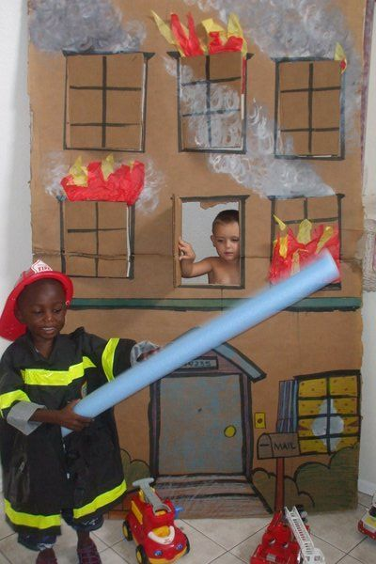
Prompt: What is an important idea from this text? Start by stating your claim. Support your claim and come to a consensus.
TEACHER VISUAL TEXT
Notes:
Display the Student Visual Text
Direct students to use their Think Time

Slide 42
Listen to the Model Constructive Conversation
  Use your think time to study the visual text.
Listen actively to what two partners say to each other.
Notes:
Provide a copy of the Model Script to the volunteer and allow time beforehand for student to review the script. Suggestions for reading the script:
● Show a video of students having the model conversation (optional)
● Model with a student using the Model Script.

Slide 43
Visual Text Model
What is an important idea from this text? Start by stating your claim. Support your claim and come to a consensus.
Partner A: An important idea from this text is that you can use your imagination to pretend. What is your claim?
Partner A: I think they used their imaginations to draw the house pretend it is on fire. How can you support your claim with evidence?
Partner A: I think the little boy in the window is using his imagination to pretend that the house is on fire and he is trying to get out. How can you support your claim with evidence?
Partner A: I think they are both using their imaginations to pretend that one is a fireman and one is in the burning house. Can we come to an agreement?
Partner B: An important idea from the text is that pretend can be like real life. How can you support your claim with evidence?
Partner B: I think the boy is pretending to be a fireman. Real firemen wear helmets and jackets. How can you support your claim with evidence?
Partner B: I think the boy is pretending that the blue tube is a water hose and he is going to use it to turn off the fire and help the boy in the house. How can we come to an agreement?
Partner B: An important idea from the visual text is that it takes imagination to play and pretend at real life things.

Slide 45
Listen to the Non-Model Constructive Conversation
  Use your think time to study the visual text.
Listen actively to what two partners say to each other.
WHAT DO YOU NOTICE IN THE VISUAL TEXT? CITE DETAILS TO CLARIFY YOUR IDEAS.
Notes:
Provide a copy of the Non-Model Script to the volunteer and allow time beforehand for student to review the script. Suggestions for reading the script:
● Show a video of students having the model conversation (optional)
● Model with a student using the Non-Model Script.

Slide 46
Visual Text Non-Model
What is an important idea from this text? Start by stating your claim. Support your claim and come to a consensus.
Partner A: An idea is they are playing.
Partner A: At the dramatic play center there is dress up clothes and toys.
Partner A: They are playing like firemen. What do you think?
Partner A: The other one is not wearing a costume.
Partner B: An idea is they are at the dramatic play center. What do you think?
Partner B: They used the firemen clothes and toy trucks.
Partner B: Only one is a fireman. What do you think?
Partner B: I like to wear costumes.

Slide 47
Constructive Conversation Game
PROMPT:
What is an important idea from this text? Start by stating your claim. Support your claim and come to a consensus.
Rules of the game:
Each of you needs 1 CREATE, 1 CLARIFY, 1 FORTIFY, and 2 NEGOTIATE cards
Each of you will play one card as you share an idea. You will continue taking turns until all cards are placed in the middle.
If you’re done early repeat the process for an additional round.
Remember to use the Constructive Conversation Norms and Skills as you play the game.
Notes:
You are now going to have the opportunity to practice the Constructive Conversation Skill NEGOTIATE while playing a game.
Explain the rules of the Constructive Conversation Game to students.

Slide 48
Prompt: What is an important idea from this text? Start by stating your claim. Support your claim and come to a consensus.
TEACHER COLLECTS LANGUAGE SAMPLE SPF 1.0
STUDENT VISUAL TEXT
Notes:
Display the Student Visual Text
Direct students to use their Think Time
As the students play the game, the teacher listens and selects two students who will replay the game in front of the class to serve as models.
This is an opportunity to capture a language sample.

Slide 49
CONSTRUCTIVE CONVERSATION
FISHBOWL MODEL
PROMPT: What is an important idea from this text? Start by stating your claim. Support your claim and come to a consensus.
Listen actively to what two partners say to each other.
FORMATIVE ASSESSMENT– TEACHER COLLECTS LANGUAGE SAMPLE SPF 1.0
Notes:
The two selected students will replay the game in front of the class and serve as models.
Student Progress Form (SPF)-­‐‑ Constructive Conversation Language Sample The teacher will collect a language sample from the two students on the Student Progress Form (SPF)-­‐‑ Constructive Conversation Language Sample to be used in Lesson 2. The language sample must be at least four turns in length. (Each turn includes both Partner A and B sharing

Slide 50
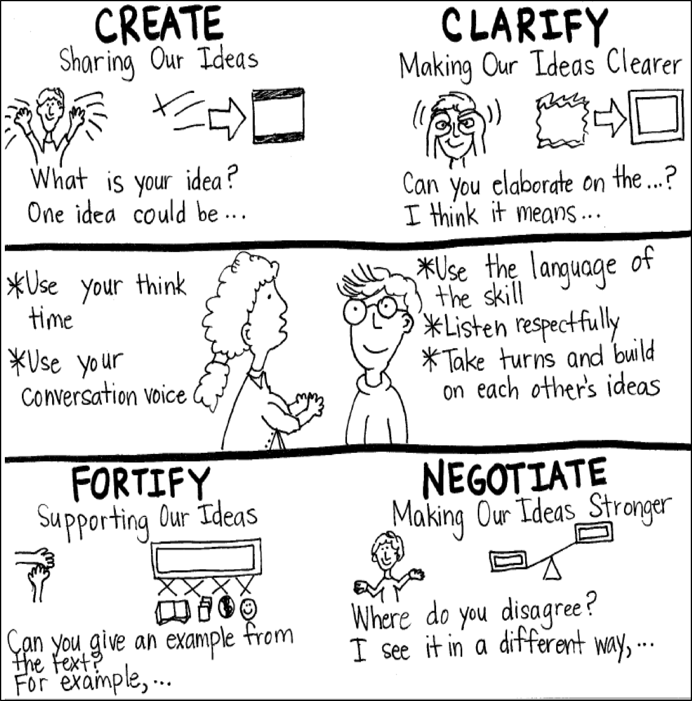
Model Creating Class Constructive Conversation Poster
Sample
Notes:
Teacher models creating a Constructive Conversation Poster. This slide is a resource. Teacher elicits student responses to help student develop a poster that illustrates their understanding of the NEGOTIATE skill and conversation norms.

Slide 51
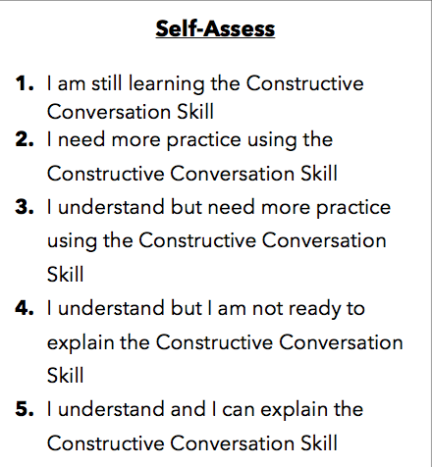
Notes:
Teacher will review the Constructive Conversation Skill NEGOTIATE
Students will self-assess answering the prompt
Teacher may select a conversation pair to share out.
EXAMPLE:
Student: I rated myself a 3 because…
Teacher: What can you do to move to a 4?

Slide 52
Teacher Resources

Slide 53
NEGOTIATE Non-Model Revision

